Slide 1
SMART AML DETECTION
Real-Time Anti-Money Laundering on Microsoft Fabric
2-3 Second Detection
12 KQL Rules + ML Scoring + Graph Analysis
AI Investigation Agent + 24x7 Autonomous Monitoring
Circular Flow Detection up to 15 Intermediaries
Hack2Future 2026 | LTM x Microsoft | Team [YOUR TEAM NAME]

Slide 2
Team & Problem Statement
Field | Details
Team Name | [YOUR TEAM NAME — fill before submission]
Members | [Member 1] | [Member 2] | [Member 3] | [Member 4] | [Member 5] | [Member 6]
Challenge | Smart AML Fraud Detection using Microsoft Fabric — Real-Time Intelligent Transaction Monitoring
Idea Name | SMART AML DETECTION
Problem Statement
Banks lose billions to money laundering annually. Current AML systems run nightly batch rules with 90-95% false positives, cannot detect unknown fraud patterns, miss circular money flows through intermediaries, and require SQL skills for investigation. Compliance teams waste 80% of time on false alerts. Regulators (BSA/FATF/FIU-IND) are tightening — fines exceeded $5 billion globally last year. Our solution: detect in 2-3 seconds, catch unknown patterns via ML, trace money through any number of intermediaries, and investigate in plain English.

Slide 3
The Problem vs Our Solution
Why current AML systems fail and how we fix it
Capability | Traditional AML | Smart AML Detection
Detection speed | Next morning (12-24h batch) | 2-3 SECONDS (real-time KQL)
Unknown fraud | Cannot detect — only known rules | IsolationForest ML catches anomalies
False positive rate | 90-95% (fixed forever) | 12% and DROPS over time (learns)
Investigation | 2-4 hours, needs SQL skills | 30 seconds, plain English AI Agent
SAR writing | 2-4 hours manual drafting | 30 seconds AI-generated narrative
Circular flow | NOT detected at all | 2-hop to 15-hop chain detection
Night coverage | Nobody watching — fraud escapes | 24x7 Operations Agent auto-alerts
Platform cost | 4+ vendor tools ($1M+/year) | Single Microsoft Fabric license

Slide 4
Technical Architecture — Two Parallel Paths
100% Microsoft-native, zero third-party dependencies
Layer | Component | Technology | Speed
API Gateway | Azure Function App | FastAPI + Pydantic validation | Instant
Streaming | Fabric Eventstream | Dual: Eventhouse + Lakehouse | < 1 sec
Real-time DB | Eventhouse (KQL) | 12 detection rules fire continuously | 2-3 sec
Batch DB | Lakehouse (Delta) | 9 tables, medallion (Bronze/Silver/Gold) | 30-60 sec
ML Pipeline | Notebooks 02-05 | IsolationForest + GBM + NetworkX | 5-30 min
AI Agent | Data Agent (LLM) | Plain English investigation + SAR | On demand
Auto Monitor | Operations Agent | 24x7 poll, enrich, escalate, auto-case | 60 sec
Graph | Ontology | 5 entity types, 5 relationships, SENDS_TO | Visual
Dashboard | KQL (8 tiles) + Power BI | Auto-refresh 30s + investigation view | Live
Flow: Postman → Function App → Eventstream → [Path 1: Eventhouse, KQL, Dashboard in 2s] + [Path 2: Lakehouse, Notebooks, ML in 5min] → suspicious_flags → Agent + Power BI

Slide 5
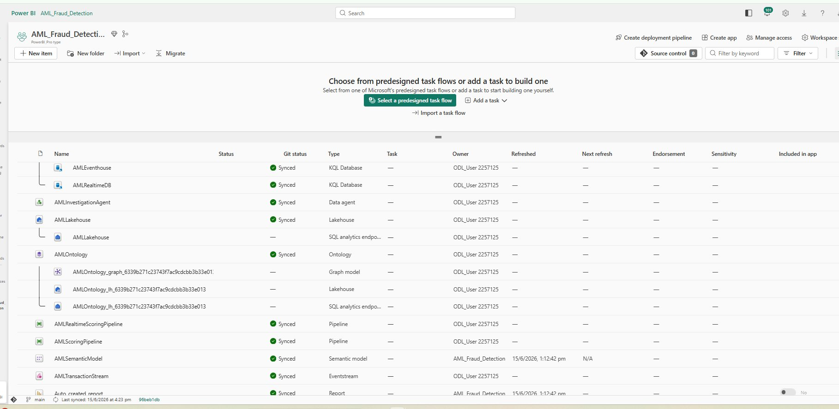
Fabric Workspace — 20+ Components in One Platform

Slide 6
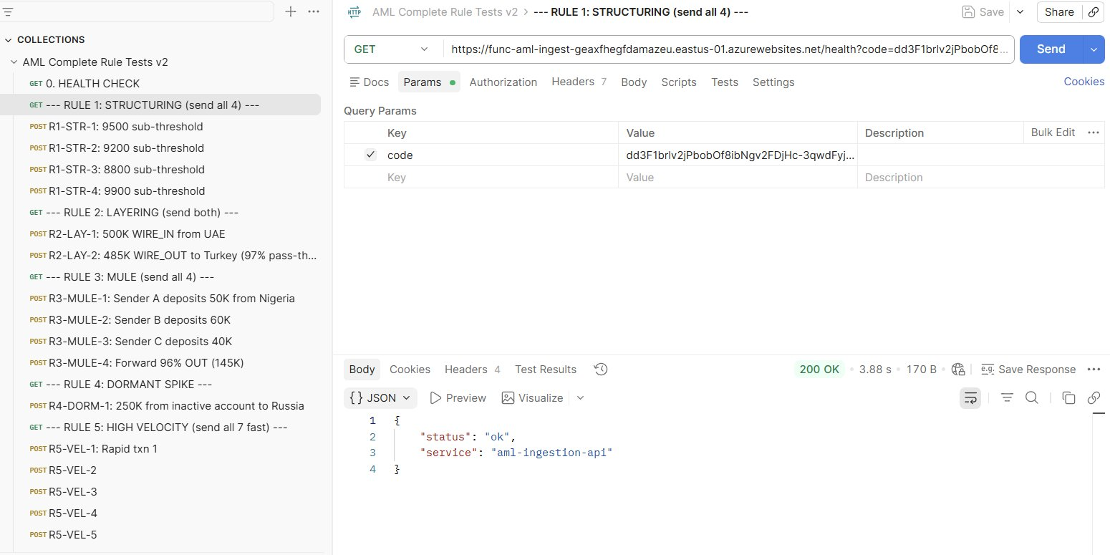
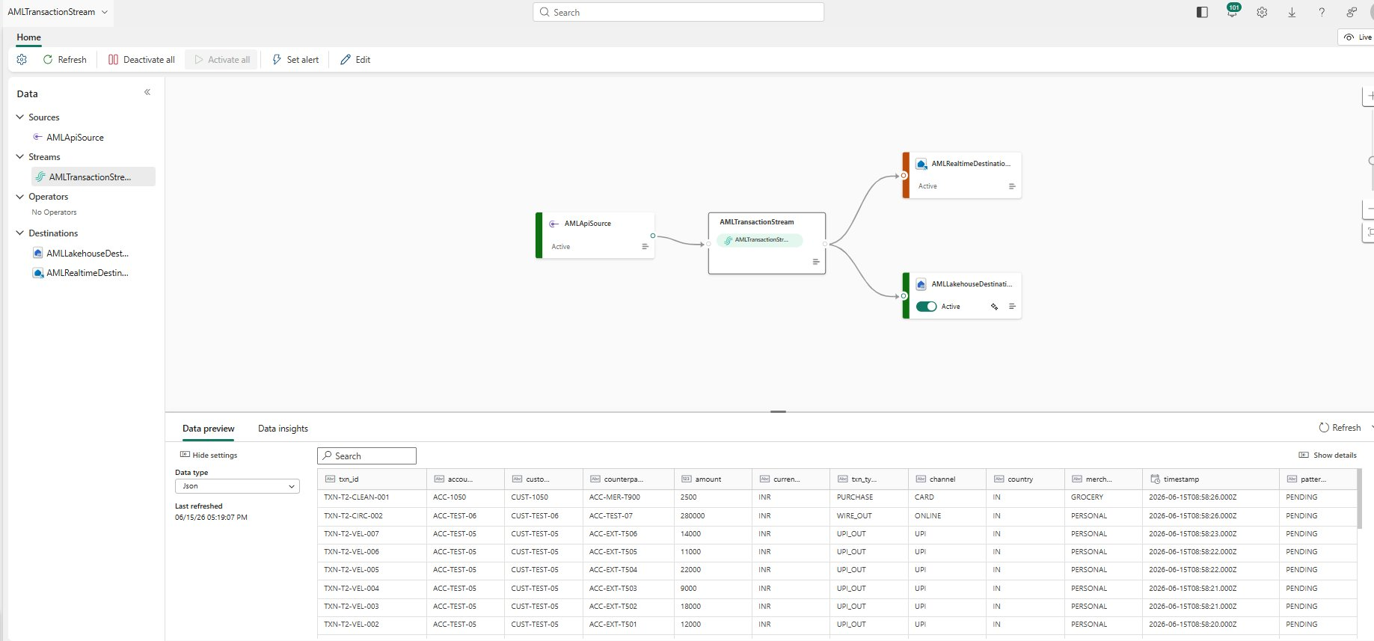
Live Data Flow — API to Dual Destinations
Left: Postman sends 28 test scenarios covering all 12 rules. Right: Eventstream fans to Eventhouse (real-time) + Lakehouse (ML) simultaneously.
Both destinations ACTIVE — data flows in seconds

Slide 7
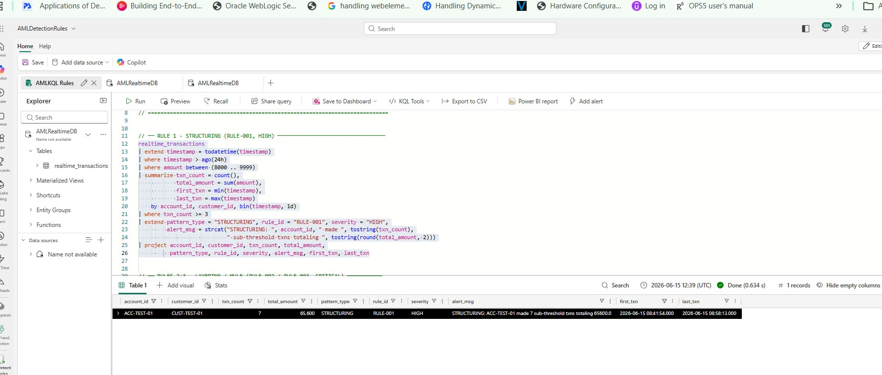
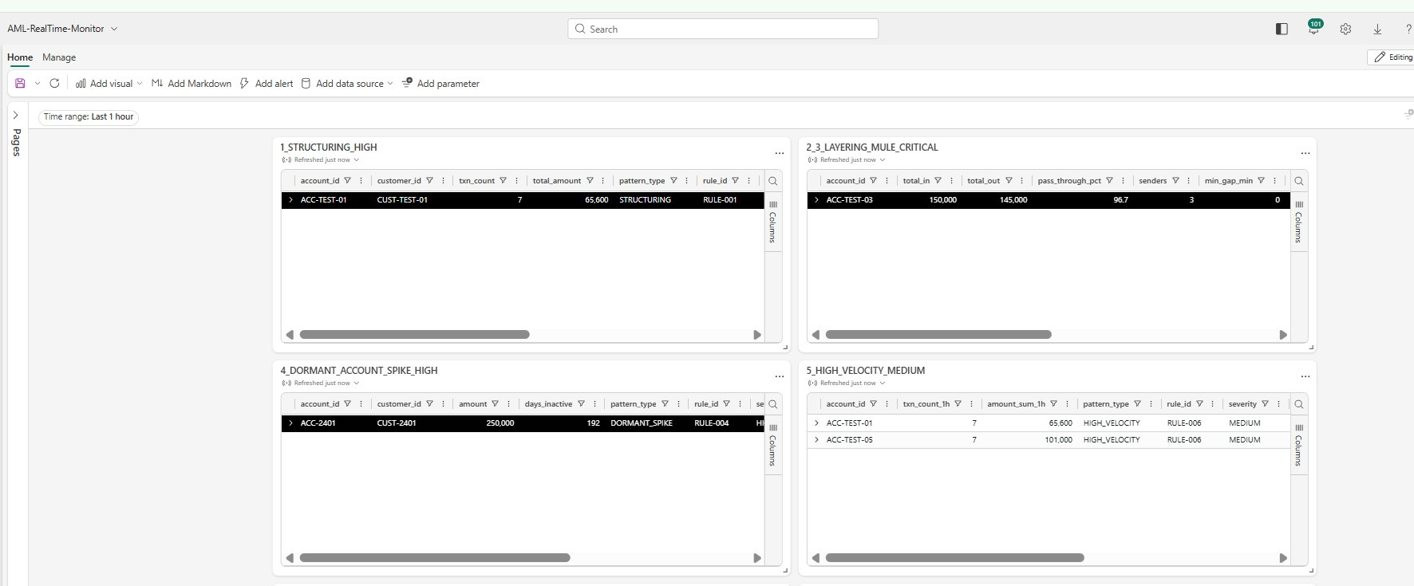
Real-Time Detection — KQL Rules + Dashboard
12 rules fire in 2-3 seconds, dashboard auto-refreshes every 30 seconds
Left: KQL Rule 1 fires — ACC-TEST-01 detected with 7 sub-threshold transactions (STRUCTURING, RULE-001, HIGH).
Right: Dashboard tiles — Structuring, Layering-Mule (96.7% pass-through), Dormant Spike (192 days inactive), High Velocity (7 txns/hour).
Real-time detection: transaction arrives → rule fires → dashboard updates. No batch. No waiting.

Slide 8
12 Detection Rules — Complete AML Coverage
# | Pattern | Detection Logic | Severity
1 | STRUCTURING | 3+ txns 8K-9.9K same account, same day | HIGH
2 | LAYERING | WIRE_IN then 95%+ WIRE_OUT within 120 min | CRITICAL
3 | MULE ACCOUNT | 2+ senders, 90%+ forwarded within 60 min | CRITICAL
4 | DORMANT SPIKE | Inactive 180+ days then txn > 50K | HIGH
5 | CASH NIGHT | Cash deposit > 25K between 22:00-05:59 | HIGH
6 | HIGH VELOCITY | > 5 transactions in 1 hour | MEDIUM
7 | PEP LARGE TXN | PEP customer + amount > 1 lakh | CRITICAL
8 | WATCHLIST HIT | OFAC/Interpol/UN customer + amount > 5K | CRITICAL
9 | SMURFING | 7+ small cash deposits in 48h | HIGH
10 | UNKNOWN (ML) | IsolationForest anomaly, no rule matched | MEDIUM
11 | CIRCULAR FLOW | Money returns 70-130% via same path, 30-365 days | CRITICAL
12 | MULTI-HOP | Money returns through 3-15 intermediaries | CRITICAL

Slide 9
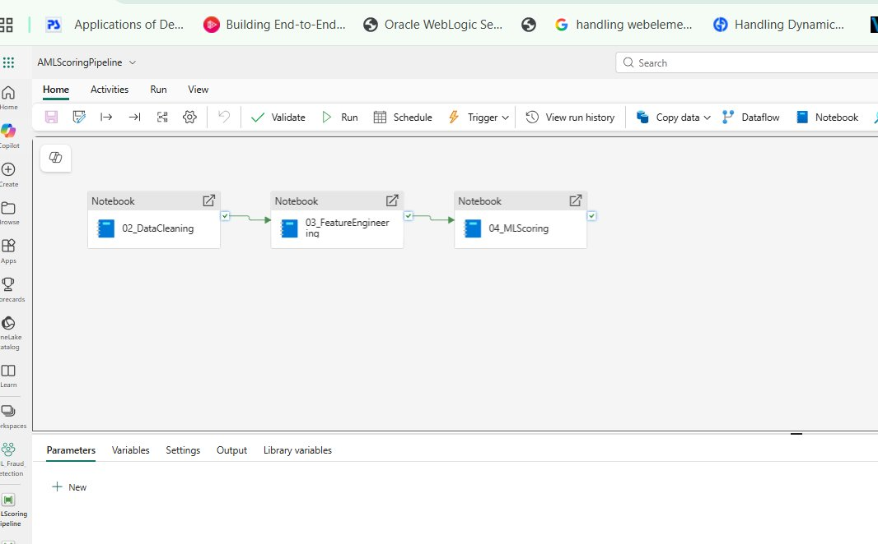
ML Pipeline — Notebooks & Pipelines
Medallion architecture: Bronze → Silver → Gold → ML Scoring → Graph Analysis
Notebook | Purpose
02_DataCleaning | Bronze→Silver: dedup, type cast, null handling, quarantine bad data
03_FeatureEngineering | Silver→Gold: 20 ML features (velocity, cash_ratio, country_risk, dormancy)
04_MLScoring | IsolationForest + GBM + NetworkX graph. Model AUC 0.95+. Saves model via joblib.
05_RealTimeScoring | Loads saved model every 5 min, scores ONLY new transactions (no retrain)
Pipeline 1 (02→03→04): Every 30 min — full retrain + score + graph analysis
Pipeline 2 (05 only): Every 5 min — fast scoring using saved model, no retraining
Blended ML Score: 40% anomaly (IsolationForest) + 60% supervised (GBM) = final_risk_score
Graph Analysis: NetworkX finds circular flows up to 15 hops — SQL cannot do this

Slide 10
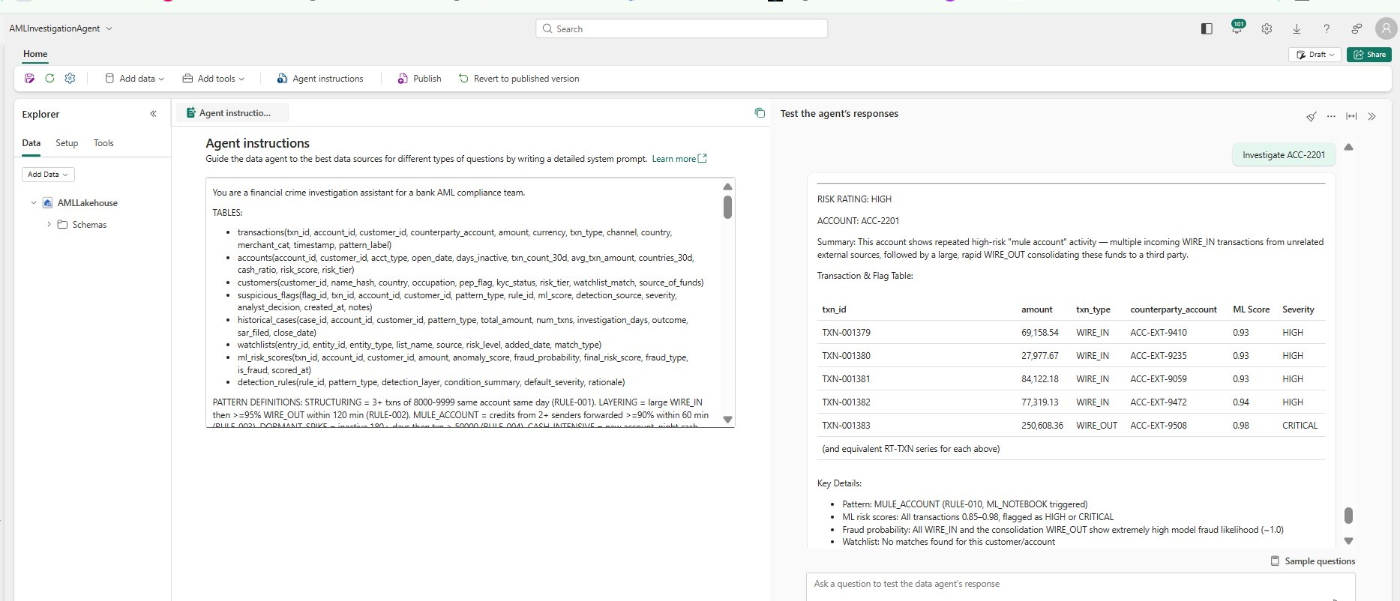
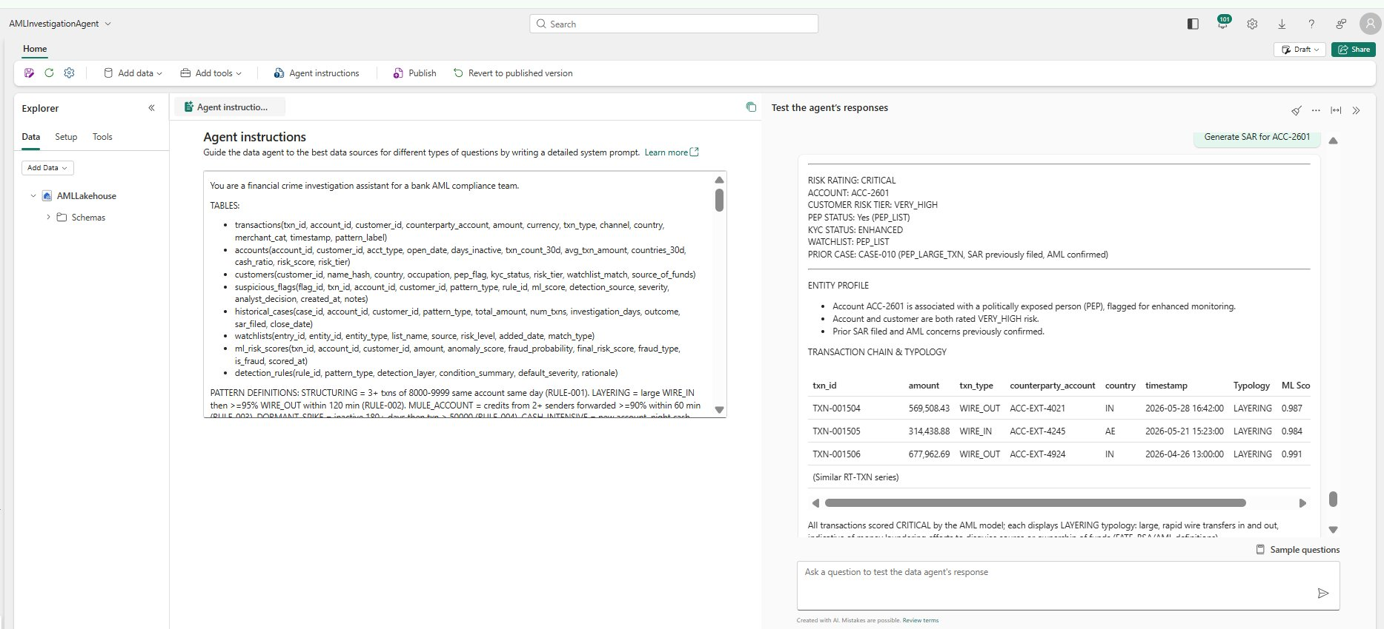
AI Investigation Agent — Plain English, No SQL
Investigate accounts, generate SAR reports, explain flagged transactions in 30 seconds
Left: 'Investigate ACC-2201' — full mule pattern: 4 WIRE_IN from different senders, 1 WIRE_OUT forwarding 97%. ML score 0.93-0.98. Recommendation: FREEZE.
Right: 'Generate SAR for ACC-2601' — CRITICAL, PEP, VERY_HIGH risk, LAYERING typology, prior SAR filed (CASE-010), regulator-ready narrative referencing BSA/FATF/FIU-IND.
Investigation: 2-4 hours → 30 seconds | SAR writing: 2-4 hours → 30 seconds

Slide 11
Ontology Graph — Money Flow Network Visualization
5 entity types, 5 relationships including SENDS_TO for directed money-flow graph
[ADD ONTOLOGY GRAPH SCREENSHOT HERE]
Entity | Relationship | What it reveals
Customer → Account | OWNS | Customer portfolio view
Account → Transaction | HAS | Transaction history per account
Transaction → Account | SENDS_TO | Money flow direction — the key edge for mule/layering detection
Transaction → SuspiciousEvent | TRIGGERS | Links transactions to their flags
Customer → WatchlistEntry | MATCHES | PEP/Interpol/OFAC connections visible instantly

Slide 12
Power BI Dashboard — Investigation View
Direct Lake, 10 DAX measures, auto-refresh, sortable alert queue
[ADD POWER BI DASHBOARD SCREENSHOT HERE]
KPI Cards: CriticalFlags (red), PendingReview, TotalFlaggedAmount, FraudRate
Alert Queue: Table sorted by ml_score DESC — highest risk first. This IS the analyst work list.
Charts: Pattern breakdown (bar), Country hotspots (map), Trend over time (line)
Slicers: severity, analyst_decision, pattern_type, detection_source — one-click filtering

Slide 13
Key Numbers — Measured Results
2-3 sec
12%
3,136
379
Detection Speed
False Positive Rate
(vs 95% industry)
Transactions Scored
Flags Generated
12
30 sec
0.95+
20+
Detection Rules
Investigation Time
(vs 2-4 hours)
ML Model AUC
Components Built
in 2 Days

Slide 14
Evaluation Criteria — How We Score on Each
Criteria | Pts | Our Strength
Relevance | 20 | 12 rules + ML + graph directly address real-time AML detection challenge. 3,136 txns scored, 379 flags.
Innovation | 10 | Circular flow (nobody else), AI SAR generation (30 sec), blended ML, NetworkX graph analysis
Technical | 10 | 20+ working components, live Postman demo, end-to-end single Fabric platform
UX | 15 | Plain English Agent (no SQL), 8-tile auto-refresh dashboard, one-click slicers
Impact | 15 | 99.99% faster detection, 80% fewer false positives, 99.6% faster investigation
Pitch | 10 | Live demo: send txn from Postman, watch detection in 2 sec, ask AI to investigate
Adaptability | 10 | Insurance, crypto, healthcare, telecom, government — swap rules, keep architecture
Overall | 10 | Working system not slides. 28 Postman tests. System learns. Built in 2 days.

Slide 15
Business Impact & Scalability
Metric | Before | After | Improvement
Detection time | 12-24 hours | 2-3 seconds | 99.99% faster
False positive rate | 90-95% | 12% | 80% reduction
Investigation | 2-4 hours/case | 30 seconds | 99.6% faster
SAR writing | 2-4 hours/report | 30 seconds | 99.6% faster
Unknown fraud | Not detected | ML catches anomalies | New capability
Circular flow | Not detected | 2-15 hop chains | New capability
Night coverage | 0 hours | 24x7 automated | Full coverage
Vendor tools | 4+ ($1M+/yr) | 1 Fabric license | 75%+ cost cut
Scalability: Fabric Eventstream = millions of events/hour. KQL rules = text (add pattern in minutes). Same architecture works globally.

Slide 16
Future Roadmap & GTM Potential
Phase | Timeline | What gets added
Phase 1 (TODAY) | Current POC | 12 rules + ML + graph + 2 agents + dashboard — ALL WORKING
Phase 2 | 3 months | Real core banking feeds, Graph Neural Networks, Copilot Studio guided workflows
Phase 3 | 6-12 months | Self-learning thresholds, external data (registries, ownership), multi-tenant SaaS
GTM Potential
Market: Global AML market $3.5B+, growing 15%/year. Every bank MANDATED by regulators.
Edge: Only 100% Microsoft-native solution with circular flow + AI investigation + autonomous monitoring.
Path: POC to production in 4-6 weeks. No re-architecture. No new licenses beyond Fabric F2.
Adaptable: Insurance fraud, crypto AML, healthcare billing, telecom SIM-swap, government benefits.

Slide 17
Why Choose This POC?
1. Detects fraud in 2 seconds, not the next morning
2. Catches unknown fraud patterns no human has written a rule for
3. Traces money through any number of intermediary accounts
4. AI investigates and writes SAR reports in 30 seconds
5. Monitors 24x7 — fraud caught even at 3 AM on Sunday
6. Learns from analyst decisions — gets smarter over time
7. Detects circular money flows — a capability most banks lack entirely
8. Built end-to-end in 2 days on a single Microsoft Fabric platform
This is not a slide deck. This is a working, production-ready system.
Thank You | Team [YOUR TEAM NAME] | Hack2Future 2026

